Slide 1


PREDICTIVE MODELING FOR INSURANCE CLAIM PROBABILITY BASED ON COMPREHENSIVE CAR POLICY FEATURES AND SAFETY RATINGS
Presented by
Kalpana S

Slide 2
Pipeline of this Project
Problem Statement
Understanding data
Importing Libraries
Loading the dataset
Exploratory Data Analysis
Feature Engineering
Splitting the data
Model Building
Hyper parameter tuning
Model Evaluation & Prediction
Conclusion

Slide 3
Problem Statement
Develop a predictive model that assesses the claim probability for car insurance policies. The objective would be to understand the factors that influence claim frequency and severity in the period of six months and enable insurance companies to better assess risk and determine appropriate premiums for policyholders.

Slide 4
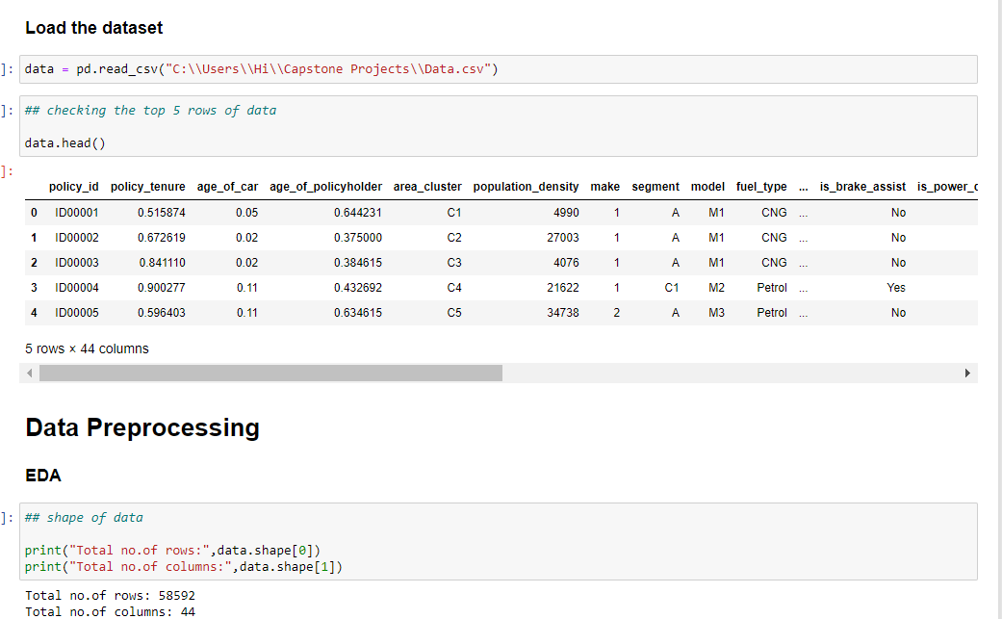
Data description

Slide 5
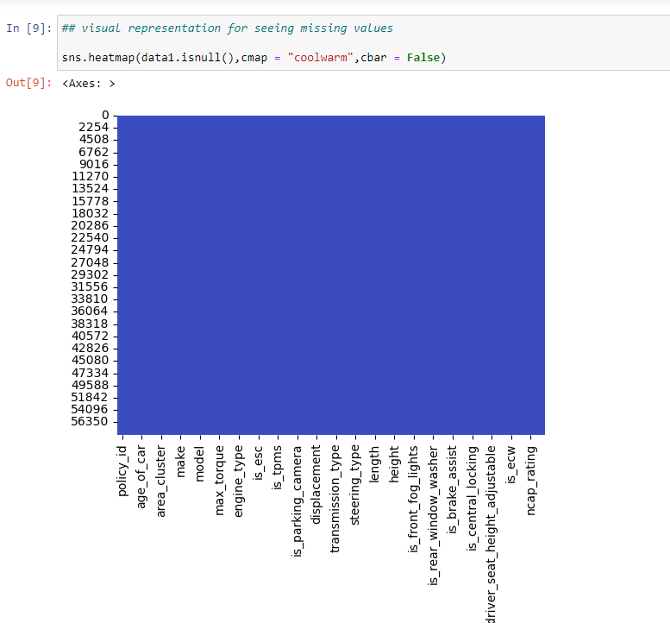
Exploratory Data Analysis
Checking for missing values:
There is no missing values in this data

Slide 6
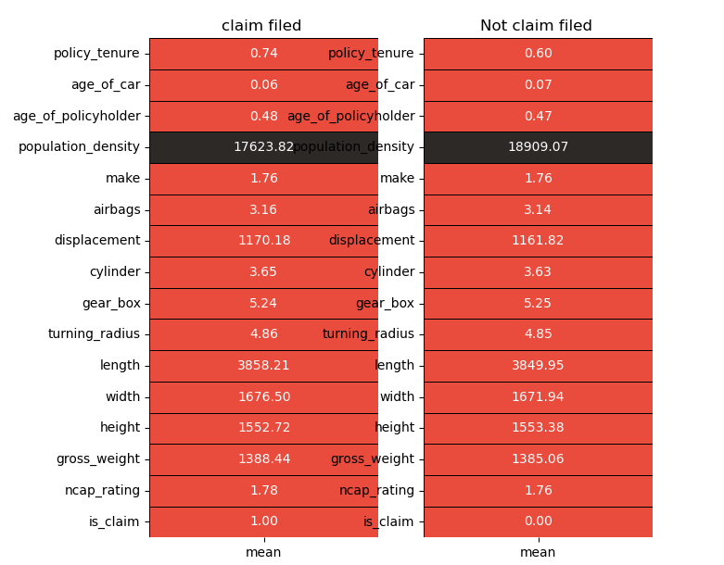
Average value of variables

Slide 7
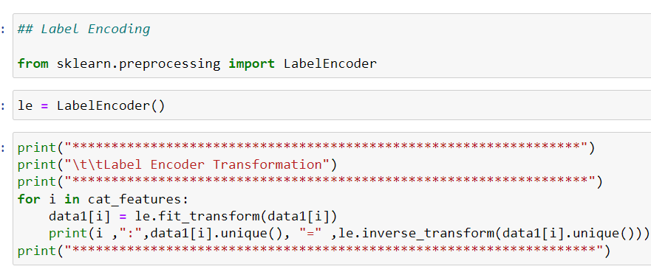
Handling of categorical variables

Slide 8
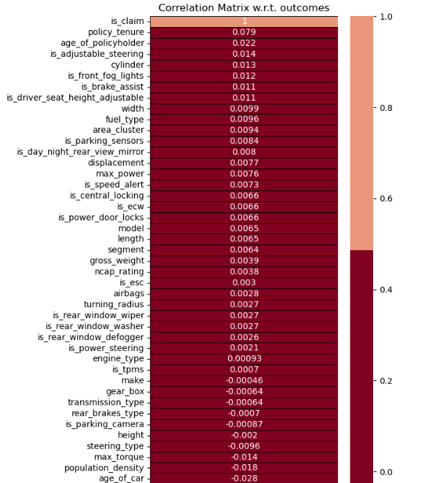

Slide 9
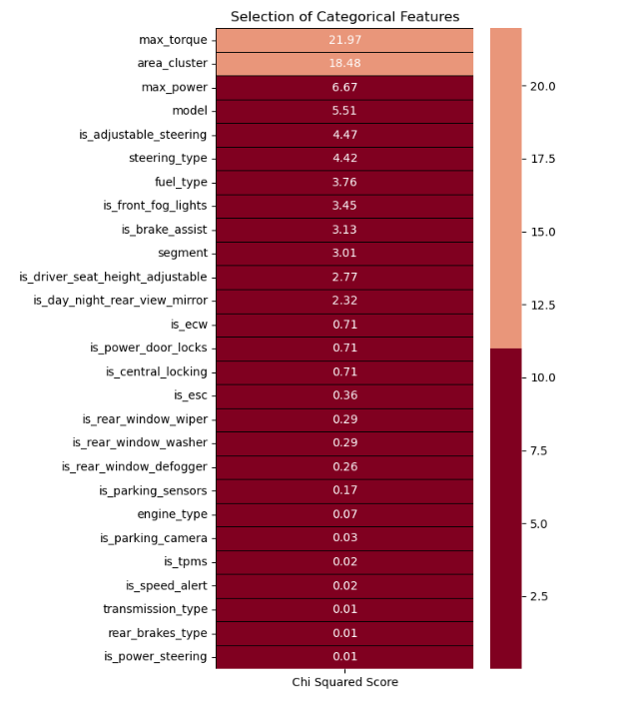
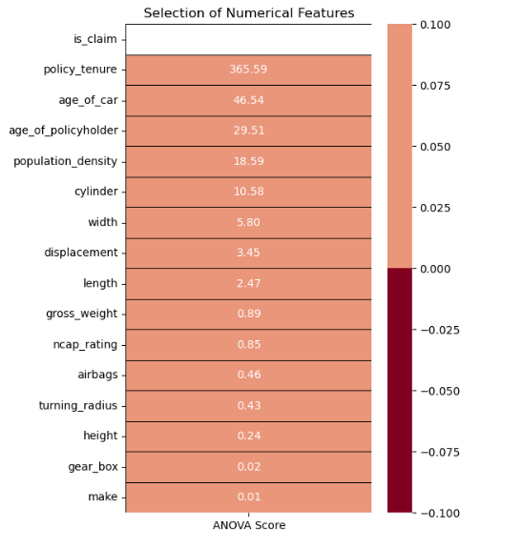
Feature Selection

Slide 10
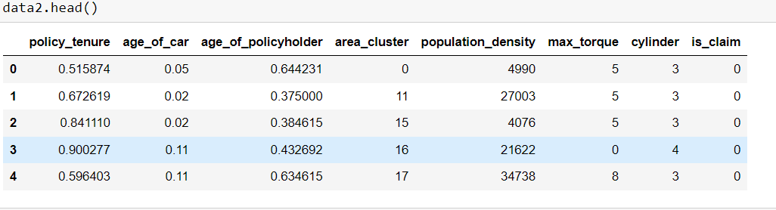
Data after dropping non-significant variables

Slide 11
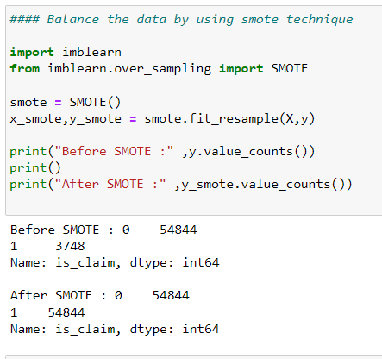
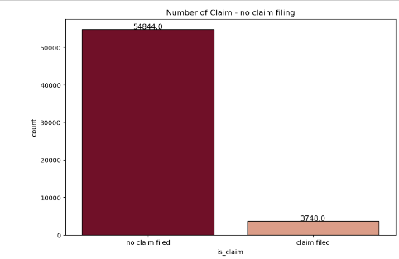
Handling Imbalance

Slide 12
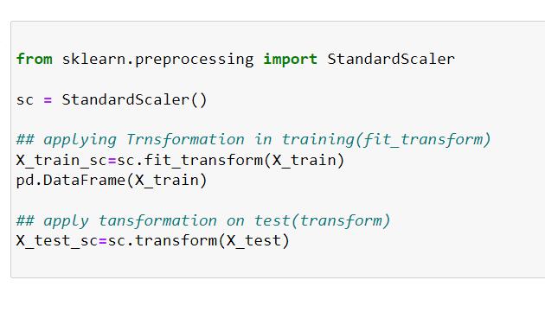
SCALING THE DATA

Slide 13
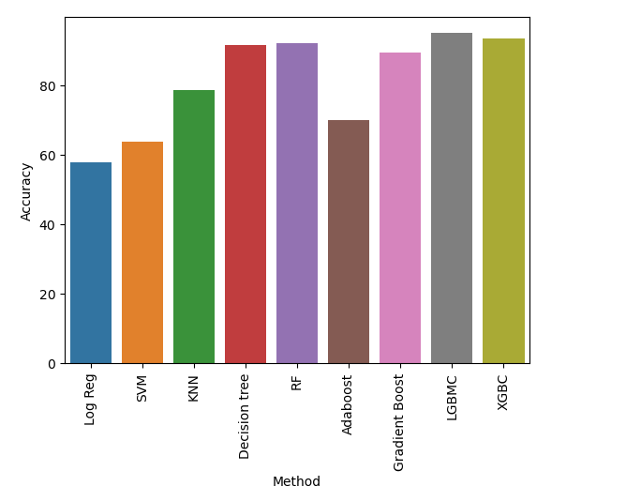
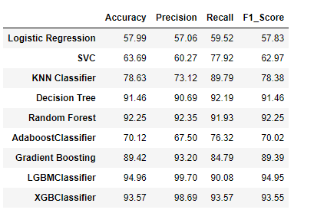
Model Performance before Hyper parameter tuning

Slide 14
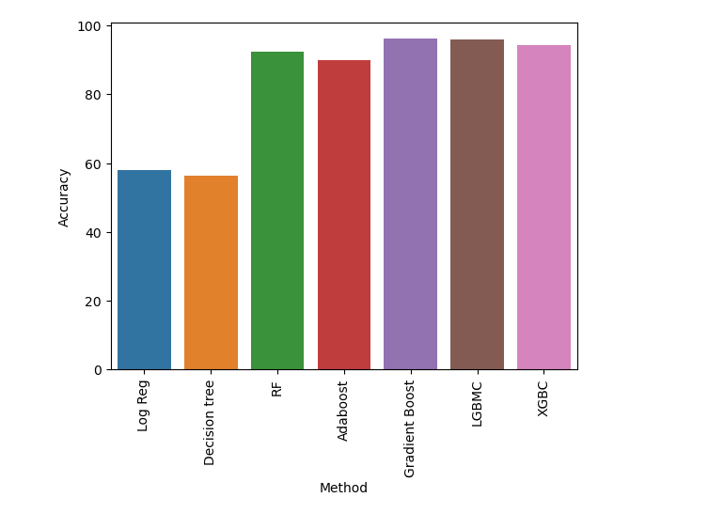
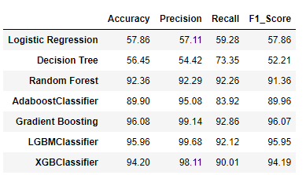
Model Performance after Hyper parameter tuning

Slide 15
CONCLUSION
We developed a predictive model for insurance claim probabilities using car policy features and safety ratings. Key phases included comprehensive data preparation, feature selection via chi-square and ANOVA, and model evaluation. After hyper parameter tuning:
Gradient Boosting achieved the highest accuracy at 96.08%.
LGBM Classifier followed closely at 95.96% accuracy.
XGBoost performed well with 94.20% accuracy.
Random Forest achieved 92.36% accuracy.
These models showcase strong predictive capabilities, enhancing insurance risk assessment and operational efficiency.

Slide 16


